Slide 1

Lecture : 2 Observational Tools & Techniques

Slide 2
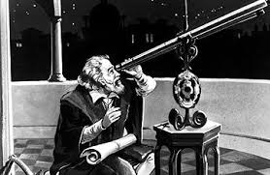
Pointing the Tube Upward
In 1608, a Dutch eyeglass maker named Hans Lipperhey invented the "spyglass" to help sailors spot distant ships.
In 1609, Galileo Galilei built his own version and did something revolutionary: he pointed it at the night sky.
This was a Refracting Telescope. It used a curved glass lens at the front to bend (refract) light to a focal point at the back.

Slide 3
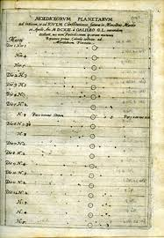
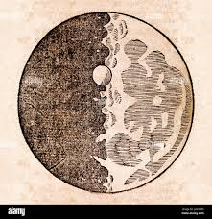
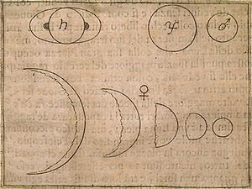
What did he observe??

Slide 4
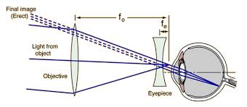
Galilean Telescope
The Galilean telescope is a classic refracting telescope. It uses glass to bend (refract) incoming light rays.
The Two Lenses: It relies on a very specific combination of just two pieces of glass:
The Objective Lens (Convex): A large lens at the front that bulges outward. It gathers the incoming parallel light rays and bends them inward toward a focal point.
The Eyepiece Lens (Concave): A smaller lens at the back that curves inward. Placed before the focal point of the objective lens, it intercepts the converging rays and straightens them out again for the human eye

Slide 5
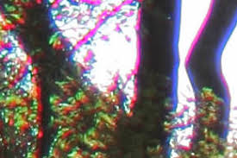
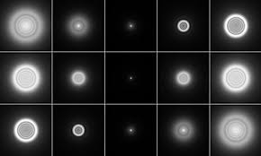
The Limits of Refraction
Chromatic Aberration (The Rainbow Blur): Glass acts like a prism. It bends shorter wavelengths (blue) sharper than longer wavelengths (red). It is physically impossible to focus all colours at once, leaving every star surrounded by a blurry, glowing rainbow halo.
Spherical Aberration (The Blurry Edges): Early lenses were ground into perfect spheres. However, the outer edges of a spherical lens bend light differently than the centre, meaning the edges of the image were always out of focus.
The Absurd Solution: To minimize these distortions, 17th-century astronomers tried making the lens curves incredibly gentle. This required massive focal lengths.
"Aerial" Telescopes: Astronomers like Hevelius built telescopes over 150 feet long! They couldn't build tubes that big, so they suspended the lens from a giant wooden mast and tried to align it with a hand-held eyepiece using ropes and pulleys in the dark.

Slide 6
Bouncing Light Instead of Bending It
Isaac Newton realized that as long as light passes through a medium like glass, it will split into a rainbow. To fix the telescope, he had to stop bending light and start bouncing it.
Unlike refraction, reflection does not depend on wavelength. Red light and blue light bounce off a mirrored surface at the exact same angle. Chromatic aberration is instantly eliminated!
The Newtonian Design: 1. Primary Mirror: A curved (concave) piece of polished metal at the back of the tube gathers the incoming light and reflects it forward to a focus. 2. Secondary Mirror: A small, flat mirror near the front is angled at 45° to bounce that converging light out the side of the tube to an eyepiece.
Newton built a working reflecting telescope that was only 6 inches long, but it magnified up to 40x matching the power of the giant, unwieldy 150-foot aerial refractors!

Slide 7
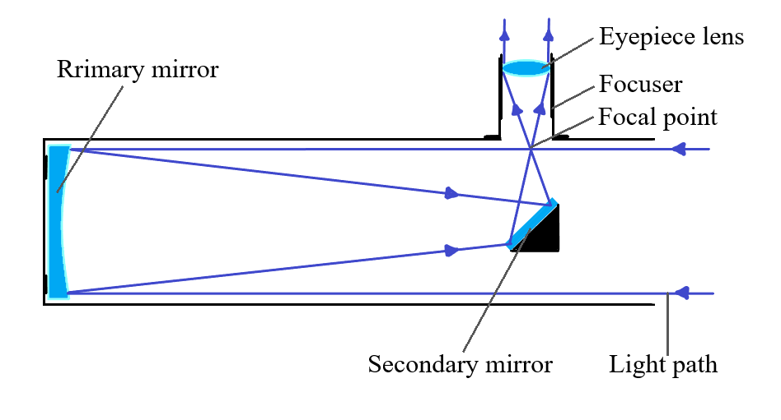
Newtonian Telescope
Light enters the open top of the telescope tube and travels unimpeded all the way down to the bottom.
At the very base sits a large, curved (concave) mirror. It catches the incoming parallel photons and reflects them back up the tube, focusing them into a narrowing cone.
Before the light cone can reach its focal point, a tiny, flat mirror suspended in the middle of the tube at a perfect 45-degree angle intercepts the beam.
The secondary mirror bounces the focused light out a hole in the side of the tube, where the observer looks through the eyepiece.

Slide 8
The Comet Hunter's Nuisance (1771)
In the 18th century, the biggest prize in astronomy was discovering a comet. French astronomer Charles Messier was completely obsessed with finding them.
Using his early telescopes, he kept spotting faint, fuzzy smudges in the deep sky. He would watch them for nights, hoping they would move like a comet. They never did.
Frustrated that these stationary fuzzy objects were wasting his time, he decided to map them so he and other comet hunters could ignore them.
He compiled a list of 110 of these "nuisances." Today, we know them as the Messier Catalogue (M1 through M110).

Slide 9
So, we cracked it right? The secret sauce, the recipe to observe the universe, higher the magnification better will be the view!!

Slide 10
Building the Ultimate "Light Bucket"
As astronomers adopted Newton's design, they realized the goal wasn't magnification, but Light Gathering Power. To see fainter objects, you simply need a wider bucket to catch more photons.
William Herschel (1781): Built massive reflectors in his backyard. By gathering more light than anyone before him, he spotted a faint object moving against the stars: Uranus the first new planet discovered since antiquity.
Lord Rosse built a monstrous 72-inch (1.8 meter) wide metal mirror in Ireland, suspended between two massive stone walls. It remained the largest telescope in the world for 70 years.
Rosse was the first human to resolve the shapes of faint "nebulae" and see giant spiral structures. He was looking at other galaxies, though he didn't know it yet!

Slide 11
We are near, but not quiet there yet!!
The human eye is basically a live-stream. It refreshes a fraction of a second, meaning it cannot "build up" light over time to see incredibly faint objects.

Slide 12
Replacing the Human Eye with Camera
In the late 19th century, astronomers started taking the eyepieces out of their giant telescopes and replacing them with glass plates coated in light-sensitive chemicals.
Unlike an eye, a camera can stay open. By forcing the telescope to perfectly track a target for hours, the chemicals slowly accumulated individual photons over time.
This was a massive paradigm shift. Photographic plates revealed faint spiral galaxies, dust lanes, and vast nebulae that were physically impossible for the human eye to ever see, no matter how big the telescope's mirror was.
Astronomy stopped being about a guy sketching what he thought he saw in the freezing dark. It became a rigorous science based on permanent, objective evidence.

Slide 13
Photographic film was a massive leap forward, but it was incredibly inefficient. It had a Quantum Efficiency (QE) of about 2%. That means for every 100 photons that hit the glass plate, only 2 actually triggered a chemical reaction.
Invented in 1969, CCDs replaced chemical plates with a grid of silicon pixels. When a photon hits a pixel, it knocks an electron loose (the photoelectric effect!), trapping it in a "bucket.”
Modern astronomical CCDs are cooled to -100°C to eliminate heat noise, and they boast a Quantum Efficiency of over 90%. They catch almost every single photon that strikes them.
Unlike film, which is subjective and messy, a CCD is perfectly linear. If a star is twice as bright, the pixel traps exactly twice as many electrons. This allows for incredibly precise Photometry (counting light).

Slide 14
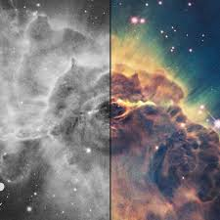
The Illusion of Colour
Space telescopes like Hubble and JWST do not have color cameras. A CCD sensor only counts how many photons hit a pixel; it doesn't know what colour they are. All raw astronomical data is strictly black-and-white.
To determine color, we place physical glass filters (Red, Green, Blue, or specific chemical bands like Hydrogen-alpha) in front of the sensor one at a time and take separate exposures.
The industry standard. It isn't a picture file; it is a massive mathematical matrix of numbers (pixel values) combined with a detailed text header containing the telescope's exact coordinates, temperature, and exposure time.

Slide 15
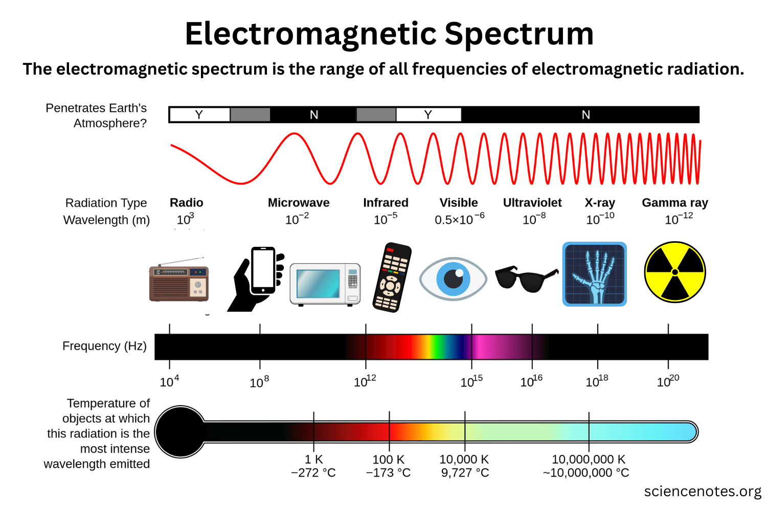

Slide 16
Photometry
Photometry is simply counting the exact number of photons hitting our CCD sensor from a specific target over a period of time.
We plot this data on a graph: Time on the x-axis and Brightness (photon count) on the y-axis.
A star's brightness isn't always constant. By watching how the light changes, we can discover invisible phenomena:
When a planet orbits in front of its host star, it blocks a tiny fraction of the light. We detect that temporary "dip" in the light curve.
We can track exactly how a star violently explodes and fades away by measuring its brightness curve over weeks.
Two stars orbiting each other, periodically blocking each other's light.

Slide 17
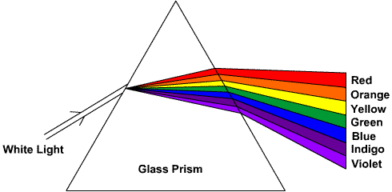

Slide 18
Spectroscopy
Instead of just counting photons, we pass the starlight through a diffraction grating (like a high-tech prism) to split it into its individual wavelengths (colours).
Every chemical element absorbs and emits light at very specific, unique wavelengths.
When we look at a star's spectrum, it looks like a continuous rainbow with very specific dark lines missing. These dark lines act like a barcode.
We can read the barcode to know exactly what elements a star is made of (Hydrogen, Helium, Iron, etc.) without ever touching it.
The overall peak colour of the spectrum tells us the surface temperature.
If the entire barcode is shifted toward the red end of the spectrum, it means the object is moving away from us!

Slide 19
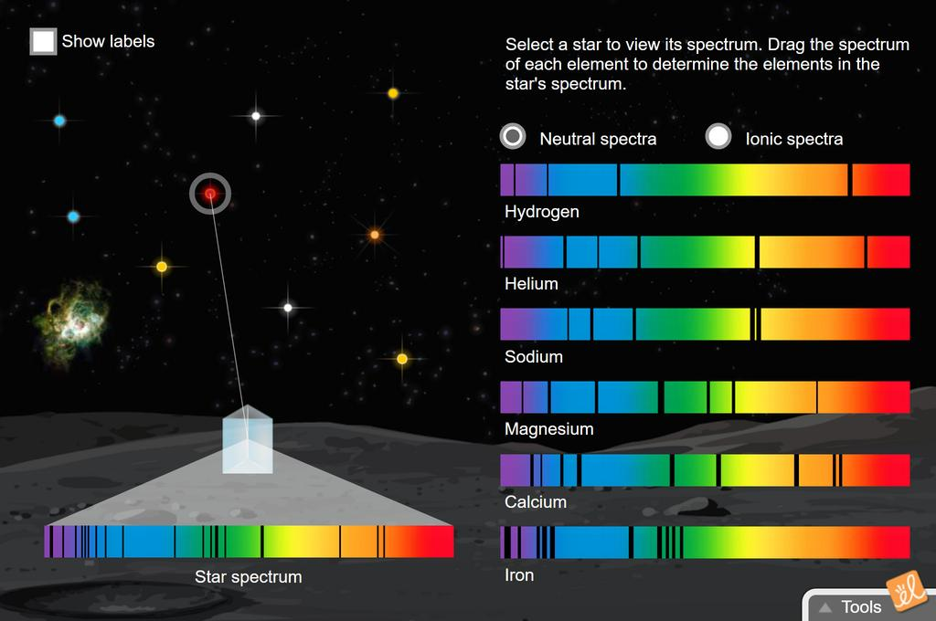

Slide 20
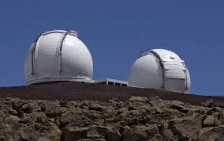
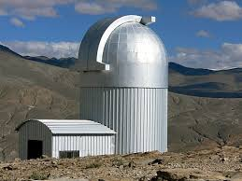
The Modern Observatory
Whether it's the James Webb Space Telescope (JWST) in deep space or the Thirty Meter Telescope (TMT) on Earth, these are essentially just massive, hyper-engineered versions of the "Light Buckets" we discussed.
Instead of a human looking through an eyepiece, these machines use super-cooled digital sensors (CCDs) that are nearly 100% efficient at catching photons.
The observatory doesn't send back photos; it beams down raw data arrays—those FITS files we talked about filled with numbers that represent photon counts at every pixel.
The real magic happens in instruments like Spectrographs. When the JWST "detects" water on a planet 100 light-years away, it’s using the exact same spectroscopy logic we just coded to find the quantum barcodes in that starlight.

Slide 21
Do we only “Receive” Visible Light?

Slide 22
We Are Practically Blind
Visible light (the colours our eyes can actually see) is just a minuscule fraction of the full Electromagnetic (EM) Spectrum.
We evolved to see visible light because our atmosphere lets it through. The atmosphere also lets in Radio waves. However, it completely blocks almost all Ultraviolet, X-ray, Gamma-ray, and most Infrared light.
Different physics produce different light.
Cold, dusty nebulae glow in Infrared.
Supermassive black holes actively feeding on stars scream in X-rays.
The leftover heat of the Big Bang itself is only visible in Microwaves

Slide 23
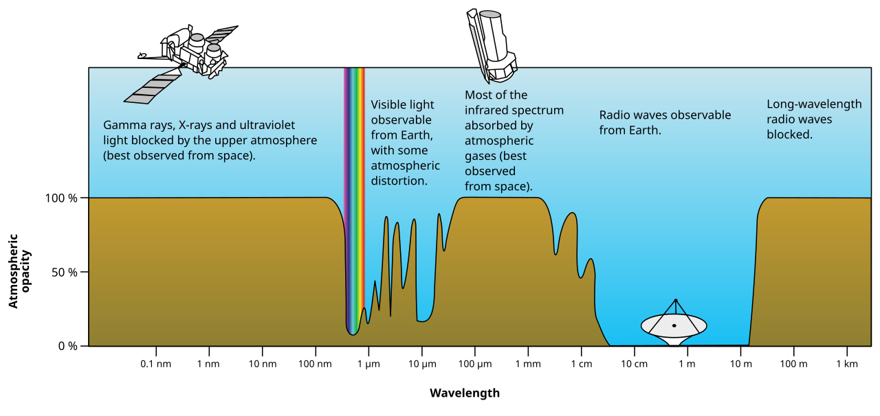

Slide 24
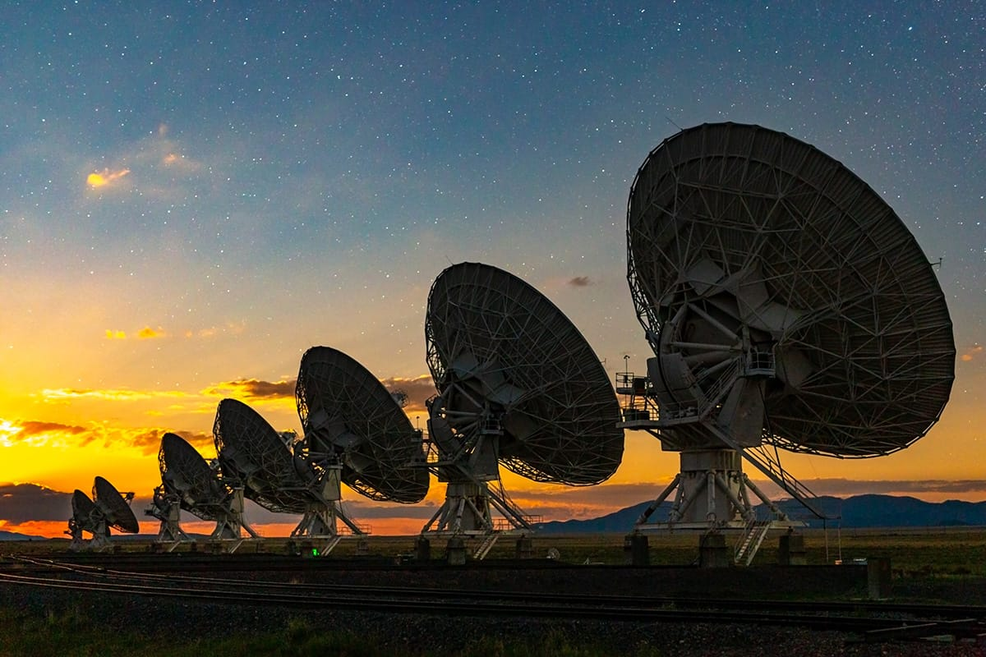
Radio Astronomy
Unlike X-rays or UV light, radio waves easily pass through both Earth's atmosphere and thick clouds of interstellar dust. We can observe them from the ground, day or night, and even in the rain!
Because radio wavelengths are massive (ranging from millimeters to dozens of meters long), we don't need perfectly polished glass mirrors. We use giant metal dishes or wire meshes to bounce these long waves into a central receiver.
But but but…..Because the wavelength of radio light is so huge, the diameter of the dish must be absolutely massive just to get a blurry image. A radio telescope the size of a football field has worse resolution than the human eye!

Slide 25
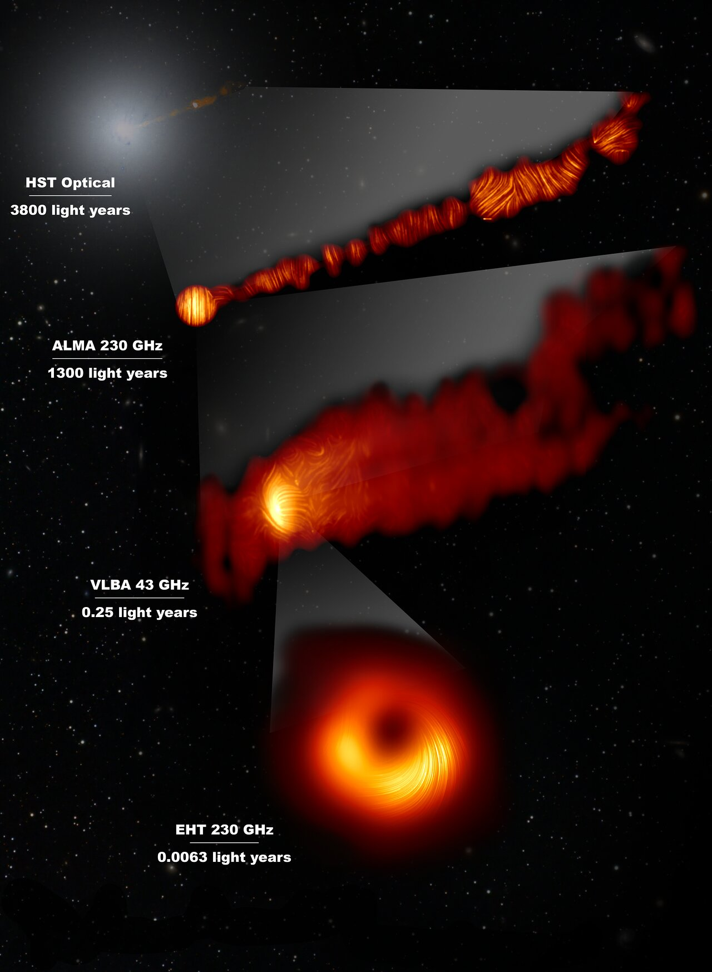
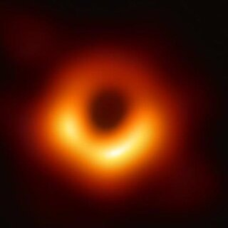

Slide 26
Interferometry
If we can't build one massive dish, we build dozens of smaller ones and spread them miles apart.
By pointing all the dishes at the same object and using supercomputers to perfectly synchronize the radio waves arriving at each dish down to the nanosecond, they mathematically act like pieces of one giant, invisible mirror.
The resolution is no longer limited by the size of a single dish, but by the maximum distance (the baseline) between the furthest dishes in the array.
The Event Horizon Telescope (EHT): By linking radio observatories across the entire planet from Hawaii to Spain to the South Pole astronomers created a virtual radio telescope the size of the Earth!
This technique gave us enough resolution to pierce through the dense, hot gas of galaxy M87 and capture the very first direct image of a supermassive black hole's shadow.

Slide 27
Now the question is do we only receive light??!!
Photons are great, but they can be blocked by dust, absorbed by gas, or trapped entirely by black holes. Fortunately, the universe sends us more than just light.
Cosmic Rays: We are constantly being bombarded by physical, subatomic shrapnel. These are protons and heavy atomic nuclei blasted out by supernovae and active galaxies, traveling at nearly the speed of light. When they hit our atmosphere, they shatter into a shower of secondary particles.
Neutrinos (The Ghost Particles): Trillions of these nearly massless particles pass through your body every second. Because they almost never interact with normal matter, they fly straight out of the dense cores of exploding stars unimpeded. To catch them, we had to build a giant detector (IceCube) buried inside a cubic kilometer of solid ice in Antarctica!
Physical Samples: Sometimes, the universe just hands us the data. Meteorites, Moon rocks, and asteroid samples (like from the OSIRIS-REx mission) allow us to put pieces of the cosmos directly under a microscope.

Slide 28
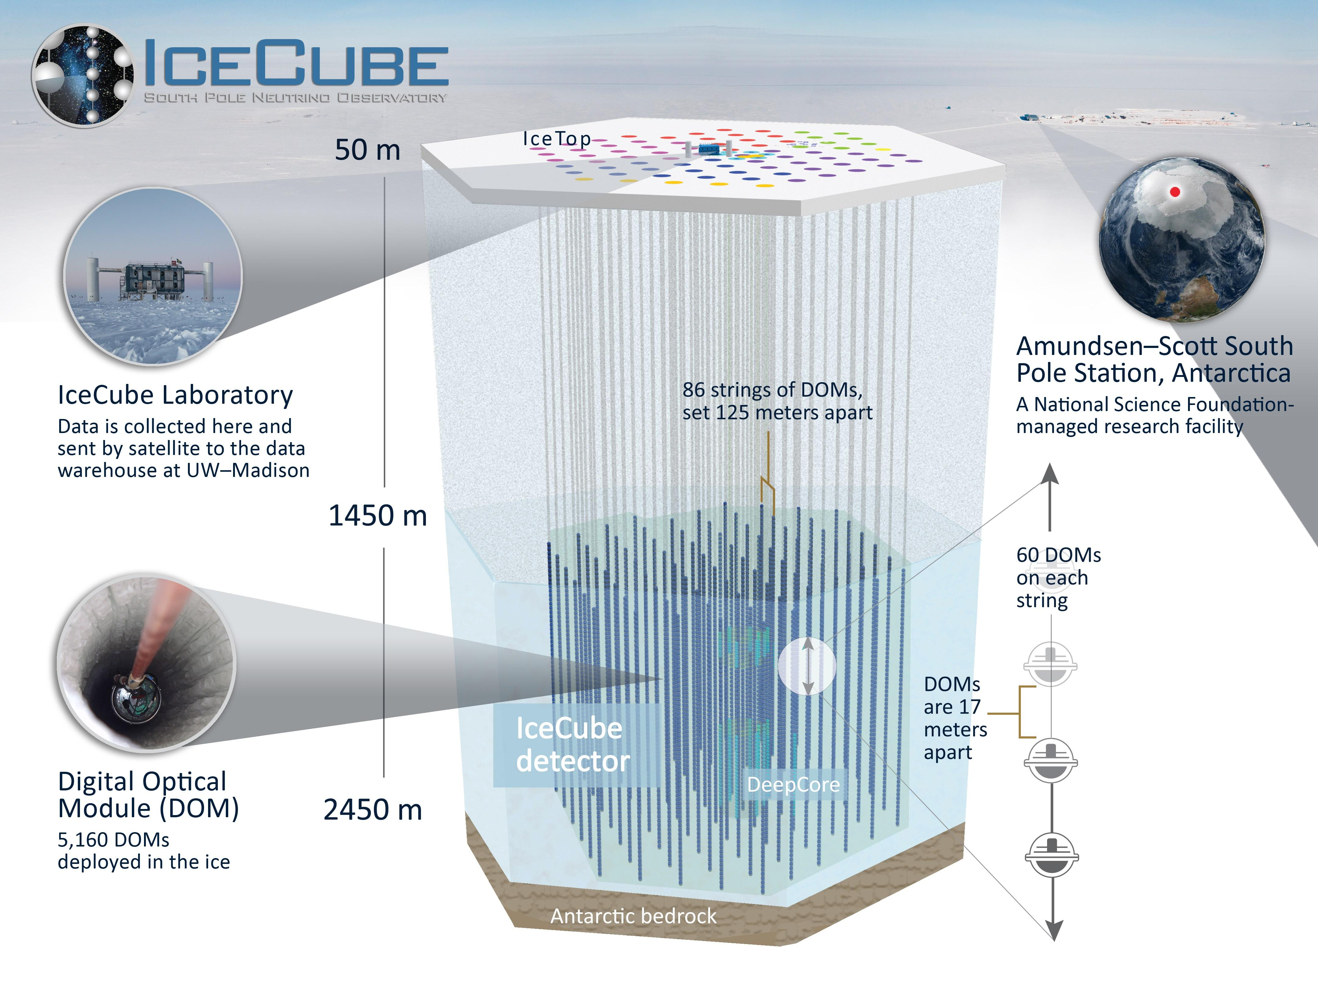
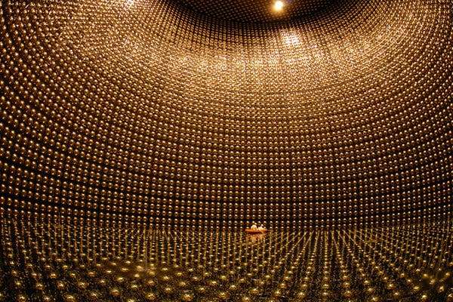

Slide 29
Ripples in Spacetime
In 2015, we detected something that wasn't a photon and wasn't a particle. We detected a vibration in the fabric of spacetime itself.
When incredibly massive, dense objects like two black holes spiral toward each other and merge, they accelerate so violently that they radiate gravitational energy, sending ripples across the universe at the speed of light.
Just like a bell rings after being struck with a hammer, a newly formed black hole "rings" as it settles into a stable state. This produces a very specific fading wave pattern characterized by Quasi-Normal Modes.
We cannot "see" these waves. Instead, we use massive, L-shaped laser interferometers with arms 4 kilometres long. As a wave passes through Earth, it literally stretches and squeezes the planet, changing the length of those laser arms by a fraction of the width of a proton!

Slide 30
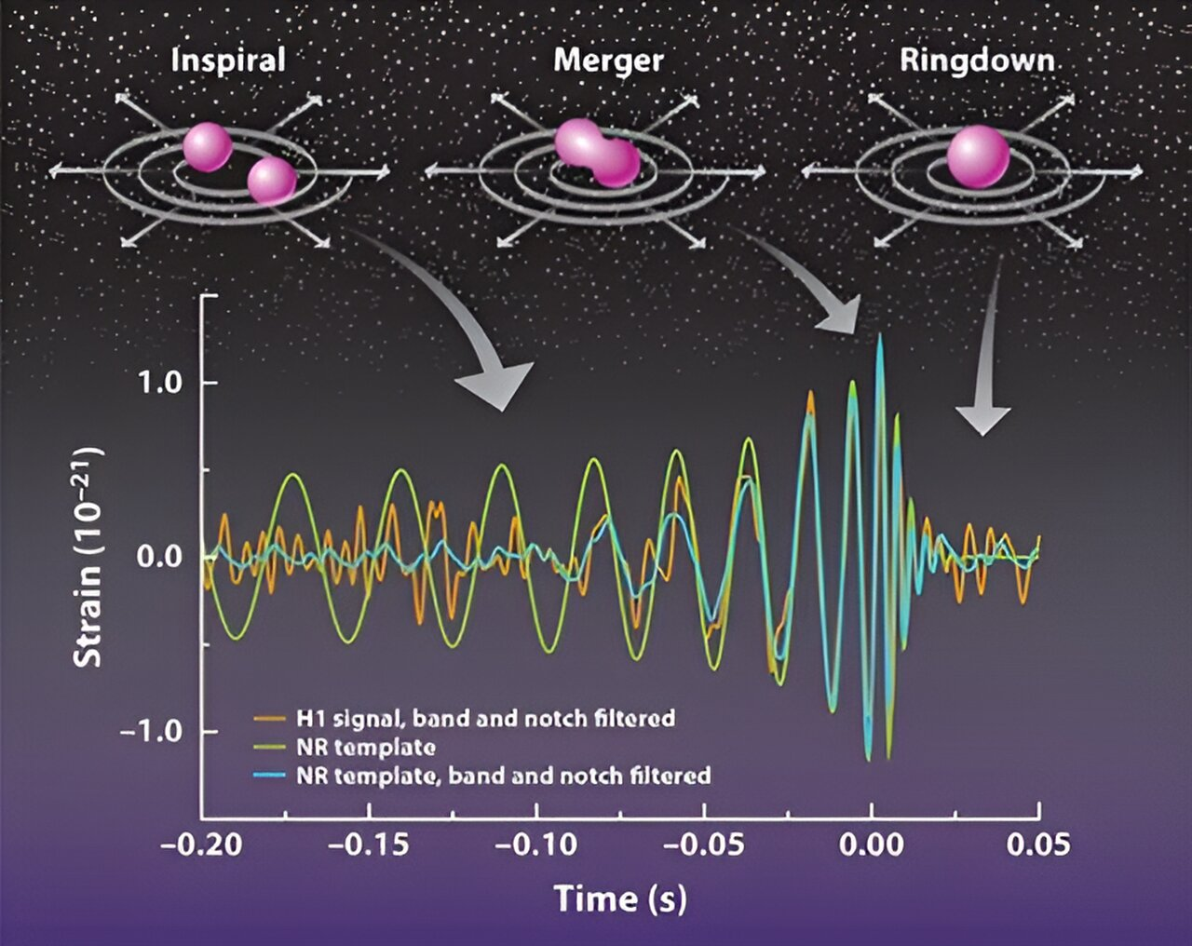
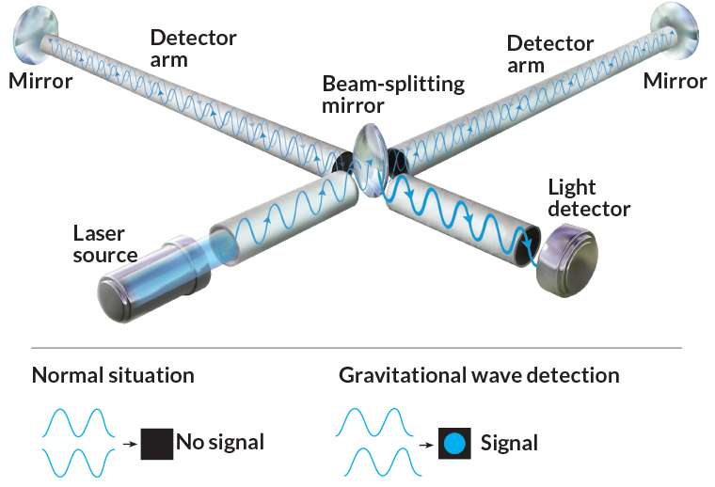

Slide 31
The Golden Rule of Data (Signal-to-Noise Ratio)
The Signal: The actual photons (or gravitational waves!) arriving from your target. This is the physics you want to measure.
The Noise: Random interference hiding your data. It comes from the sky glowing, thermal heat inside the telescope's electronics, and the quantum randomness of light itself (Poisson noise).
The Equation: In astronomy, the noise scales with the square root of the total photons collected N.
To double your SNR, you can't just double your exposure time; you have to take four times as many exposures. This is why astrophotographers and space telescopes take hundreds of individual images and mathematically average (stack) them together!

